Slide 1
Figure 1: ADSP summary
A
B
ε3/ε3: 57%
ε2/ε2: 0%
ε2/ε3: 7%
ε2/ε4: 1%
ε3/ε4: 35%
C
Age
Sex: M F
APOE
ε3/ε3
ε2/ε2
ε2/ε3
ε2/ε4
ε3/ε4
Notes:
Figure 1. Summary statistics of the ADSP whole genome sequencing project participants.
A. AD diagnosis for 570 individuals across 111 families. B. APOE allele-type composition. C. Age distributions of individuals in each AD status (left). Sex composition in each AD status (middle). APOE allele-type composition in each AD status (right)

Slide 2
Figure 2: Bayes-GLMM estimation of covariates
A
B
Age -
Cut 1 -
Age
c1
Sex -
Cut 2 -
c2
APOE/e2
APOE/ε2 -
Cut 3 -
c3
APOE/ε4 -
APOE/e4
0
2
4
6
-1
0
1
Effect size
Effect size
Notes:
Figure 2. MCMC sampling of GLMM. (a) cut points of the ordered categorical model. (b) Additive covariate: age, sex, APOE/e2 and APOE/e4.

Slide 3
Figure 3: GWAS of ADSP WGS cohort by Bayes-GLMM
AD status of 570 participants
Covariates: age and sex
Autosomal SNP call by ADSP consortium (27.9 million)
Data
MAF cutoff 0.01 (10.3 million)
IBS kinship relatedness
GLM without random term, flat priors, model inference by MLE
Pre-scan
P-value cutoff 0.0001 (9726)
GLMM with random term, flat priors, model inference by MCMC
Scan
Posterior distribution of variant effects
Notes:
Figure 3. GWAS of ADSP WGS cohort by Bayes-GLMM. Phenotypic trait was AD diagnosis of 570 participants. Age and sex was included as model covariates. 10.3 million genomic variants with MAF > 0.01 were used for kinship computing and the pre-scan by GLM. 9726 variants with P-values smaller than 0.0001 from the pre-scan were used for the second scan with GLMM.

Slide 4
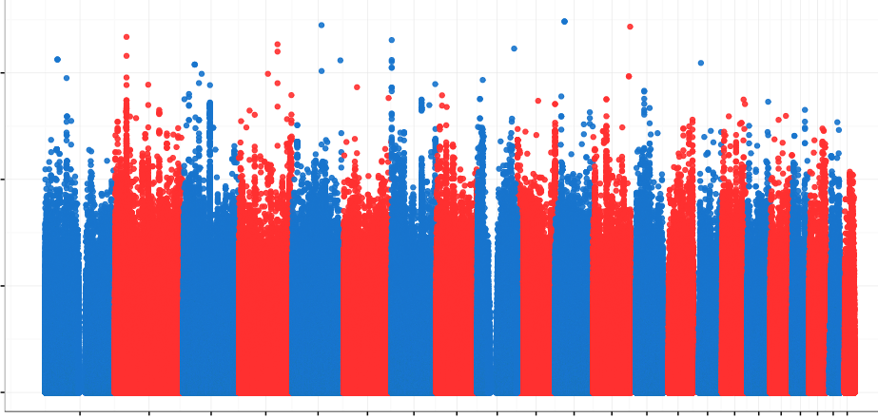
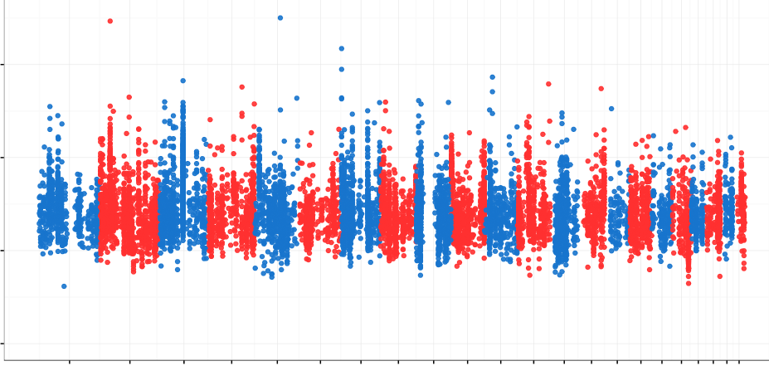
Figure 4: GWAS of ADSP WGS cohort by Bayes-GLMM
A
7.5
5.0
-log10(P)
2.5
0
1 3 5 7 9 11 13 15 17 19 21
B
2 4 6 8 10 12 14 16 18 20 22
Chromosome
rs10490263
rs74944275
rs149372995
7.5
rs140233081
5.0
-log10(P)
2.5
0
1 3 5 7 9 11 13 15 17 19 21
2 4 6 8 10 12 14 16 18 20 22
Chromosome
Notes:
Figure 4. (a) GWAS on 10.3 genomic variants by Bayes-GLMM without kinship correction. Model parameters were estimated by MLE. Variants with p-values smaller than 0.0001, above the grey area, were chosen for the next scan. (b) GWAS on filtered variants. Model parameters were estimated by MCMC sampling. Dashed line was genome wide significance cutoff (5e-8).

Slide 5
Figure 5: Top GWAS variants
rs74944275
rs149372995
rs140233081
rs10490263
Notes:
Figure 3. (a) Top variants with p-values smaller than 1e-6. (b) Functional consequences of the top 244 variants (bar graph?).

Slide 6
Figure 6: Effects of priors
A
Effect size with
flat prior
Post Effect Size
B
Standard error of effect size with flat prior
Post Standardized Error of Effect Size
C
Post Standardized Effect Size
Standardized effect size with flat prior
D
Post p-value
P-value with flat prior
Prior Standardized Effect Size
Notes:
Figure 6. Effects of priors.

Slide 8
Supplementary Figure 1
Notes:
Supplementary Figure 1. No interaction was detected between each pair of the covariates (age, sex, APOE/e2, APOE/e4).

Slide 9
Supplementary Figure 2
Notes:
Supplementary Figure 2. Summary statistics of the ADSP variants.

Slide 10
Supplementary Figure 3: GWAS of ADSP WGS cohort by Bayes-GLMM
A
7.5
5.0
-log10(P)
2.5
0
1 3 5 7 9 11 13 15 17 19 21
B
2 4 6 8 10 12 14 16 18 20 22
Chromosome
7.5
5.0
-log10(P)
2.5
0
1 3 5 7 9 11 13 15 17 19 21
2 4 6 8 10 12 14 16 18 20 22
Chromosome
Notes:
Figure 4. (a) GWAS on 10.3 genomic variants by Bayes-GLMM without kinship correction. Model parameters were estimated by MLE. Variants with p-values smaller than 0.0001, above the grey area, were chosen for the next scan. (b) GWAS on filtered variants. Model parameters were estimated by MCMC sampling. Dashed line was genome wide significance cutoff (5e-8).

